Slide 1
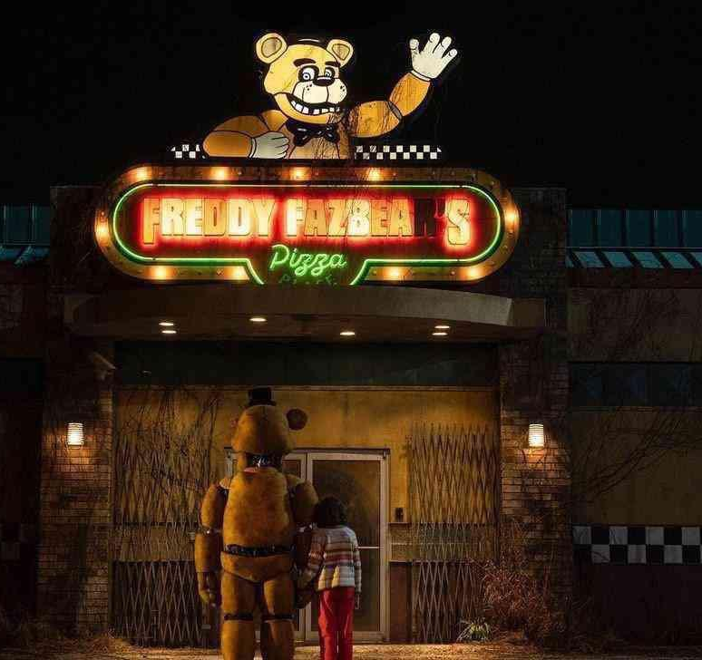
FIve Nights
At FREDDY'S
Movie Review
Ana Antanasijević

Slide 2
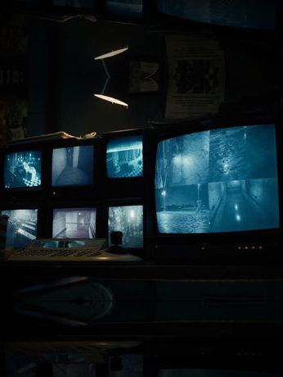
INTRODUCTION
Five Nights at Freddy's movie is directed by Emma Tammi, who co-wrote the screenplay with Scott Cawthon and brought the iconic video game to the big screen. The film excelled in capturing the eerie atmosphere and animatronic characters from the game, which quickly led to discussions about a film adaptation.

Slide 3
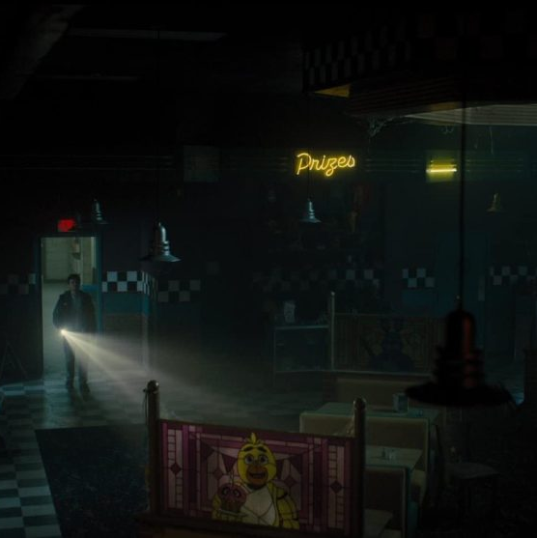
ATMOSPHERE
One of the film's most significant accomplishments was its production design. The animatronics, true to their in-game counterparts, were meticulously crafted, capturing the unsettling feel of the original characters. The atmosphere within Freddy Fazbear's Pizza, with its eerie lighting and claustrophobic corridors, effectively created the tension and dread that the game series is renowned for.

Slide 4
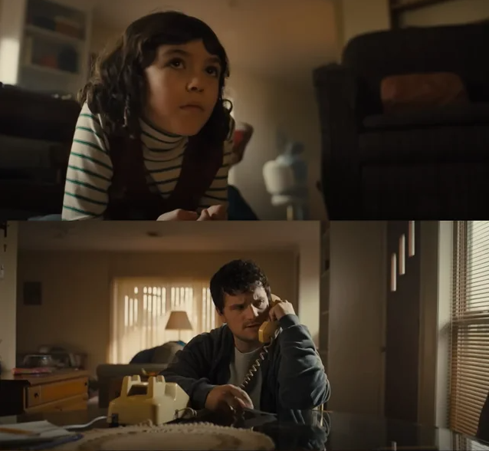
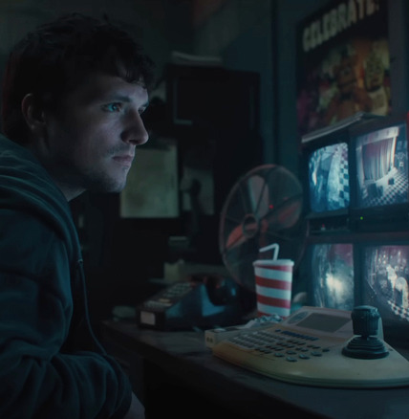
Synopsis
The film follows Mike, a troubled young man caring for his 10-year-old sister Abby and haunted by the unsolved disappearance of his younger brother more than a decade before.
Recently fired and desperate for work so that he can keep custody of Abby, Mike agrees to take a position
as a night security guard at: Freddy Fazbear's Pizzeria,
a once-successful but now abandoned family entertainment center.

Slide 5
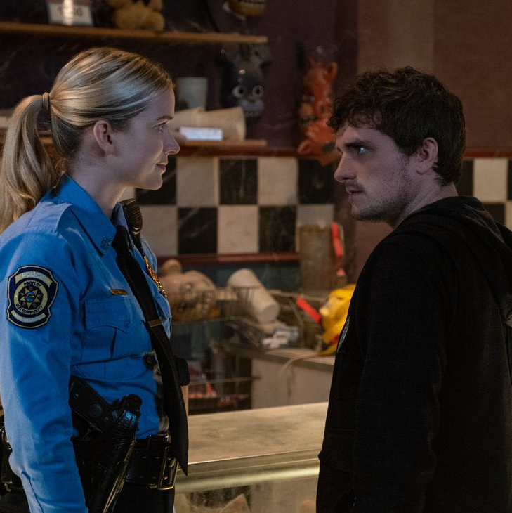
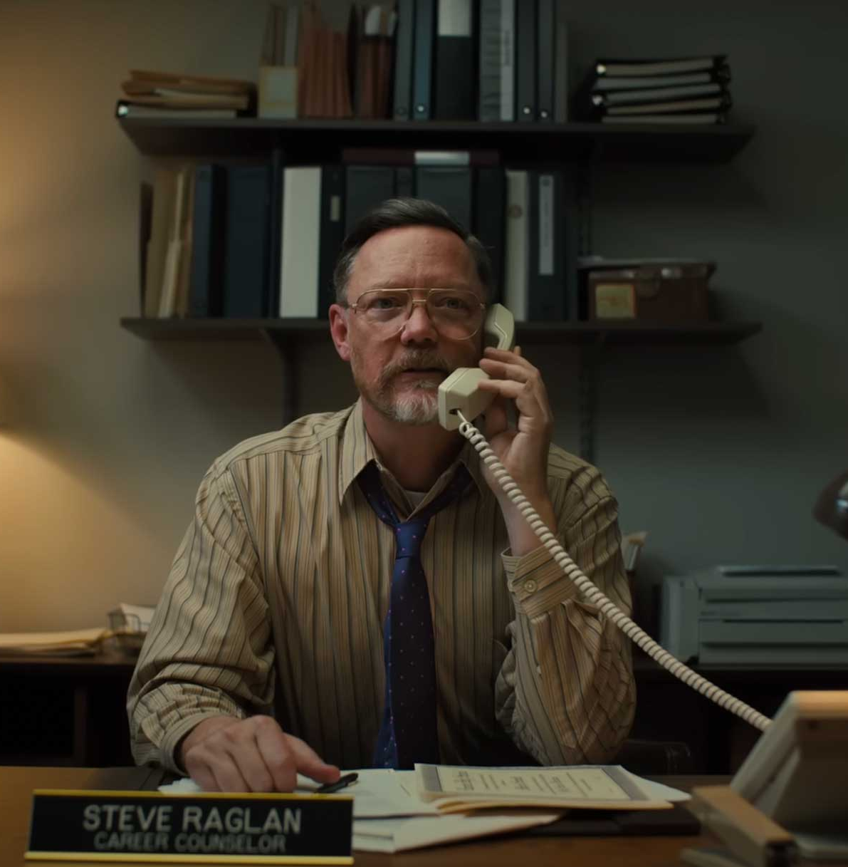
Synopsis
During his first night on the job, he realizes that the night shift won't be so easy to get through. Pretty soon he will unveil what actually happened at Freddy's.
Mike discovers that nothing at Freddy's is what it seems. With the aid of Vanessa, a local police officer, Mike's nights at Freddy's will lead him into unexplainable encounters with the supernatural and drag him into the black heart of an unspeakable nightmare.

Slide 6
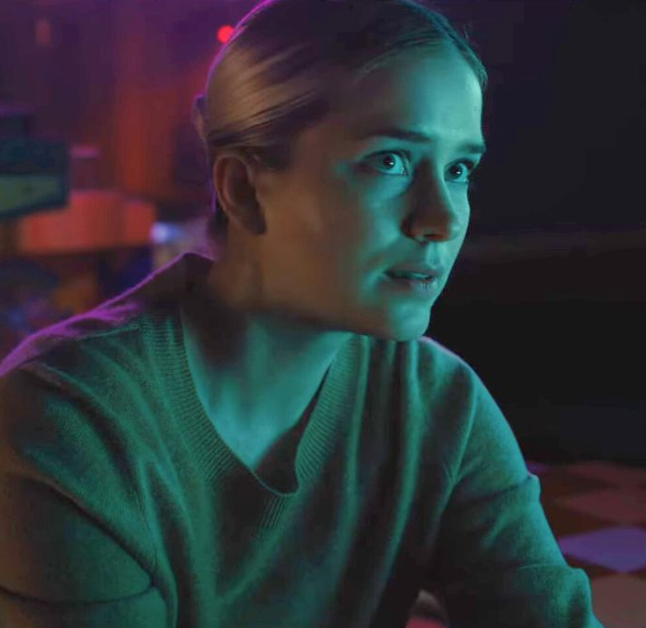
MAIN CAsT
Josh Hutcherson as Mike Schmidt, a new security guard at Freddy Fazbear's Pizza
Elizabeth Lail as Vanessa, a local police officer
Piper Rubio as Abby Schmidt, Mike's younger sister
Matthew Lillard as Steve Raglan / William Afton, Mike's career counselor
Mary Stuart Masterson as Aunt Jane, Mike's aunt
Kat Conner Sterling as Max, Abby's babysitter
Lucas Grant as Garrett

Slide 7
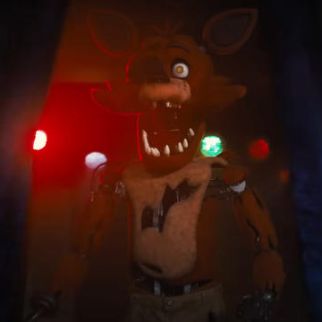
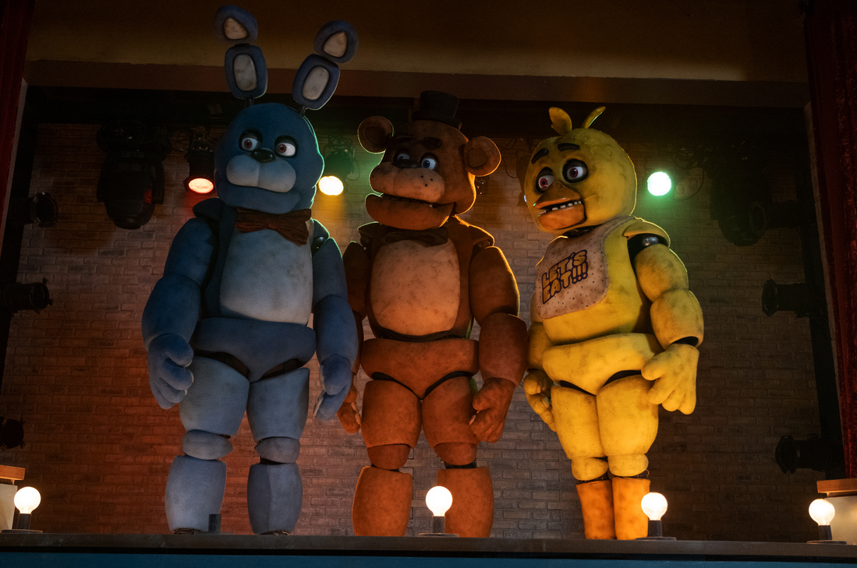
Voices
Kevin Foster as Freddy Fazbear
Jade Kindar-Martin as Bonnie the bunny
Jessica Weiss as Chica the chicken
Roger Joseph Manning Jr. as Foxy the pirate fox

Slide 8
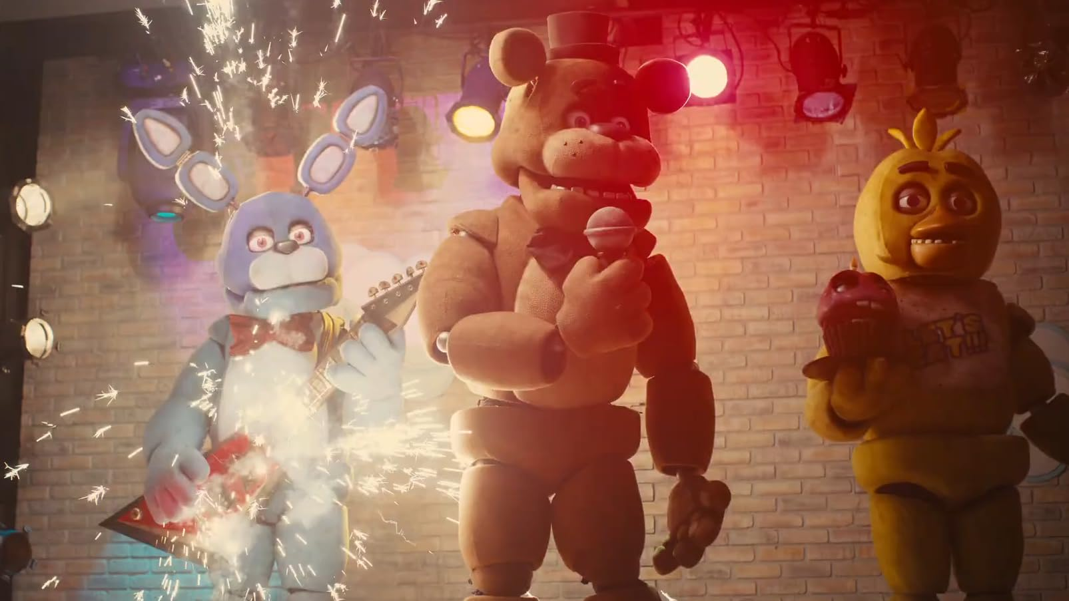
Lore / STORYLINE
The storyline of "Five Nights at Freddy's" revolves around a series of eerie and unsettling events that take place at Freddy Fazbear's Pizza, a fictional restaurant inspired by the likes of Chuck E. Cheese's. The "Five Nights at Freddy's" storyline is a testament to the power of atmospheric horror, jump scares, and the thrill of piecing together a dark and enigmatic narrative within a seemingly innocent setting.

